Slide 1
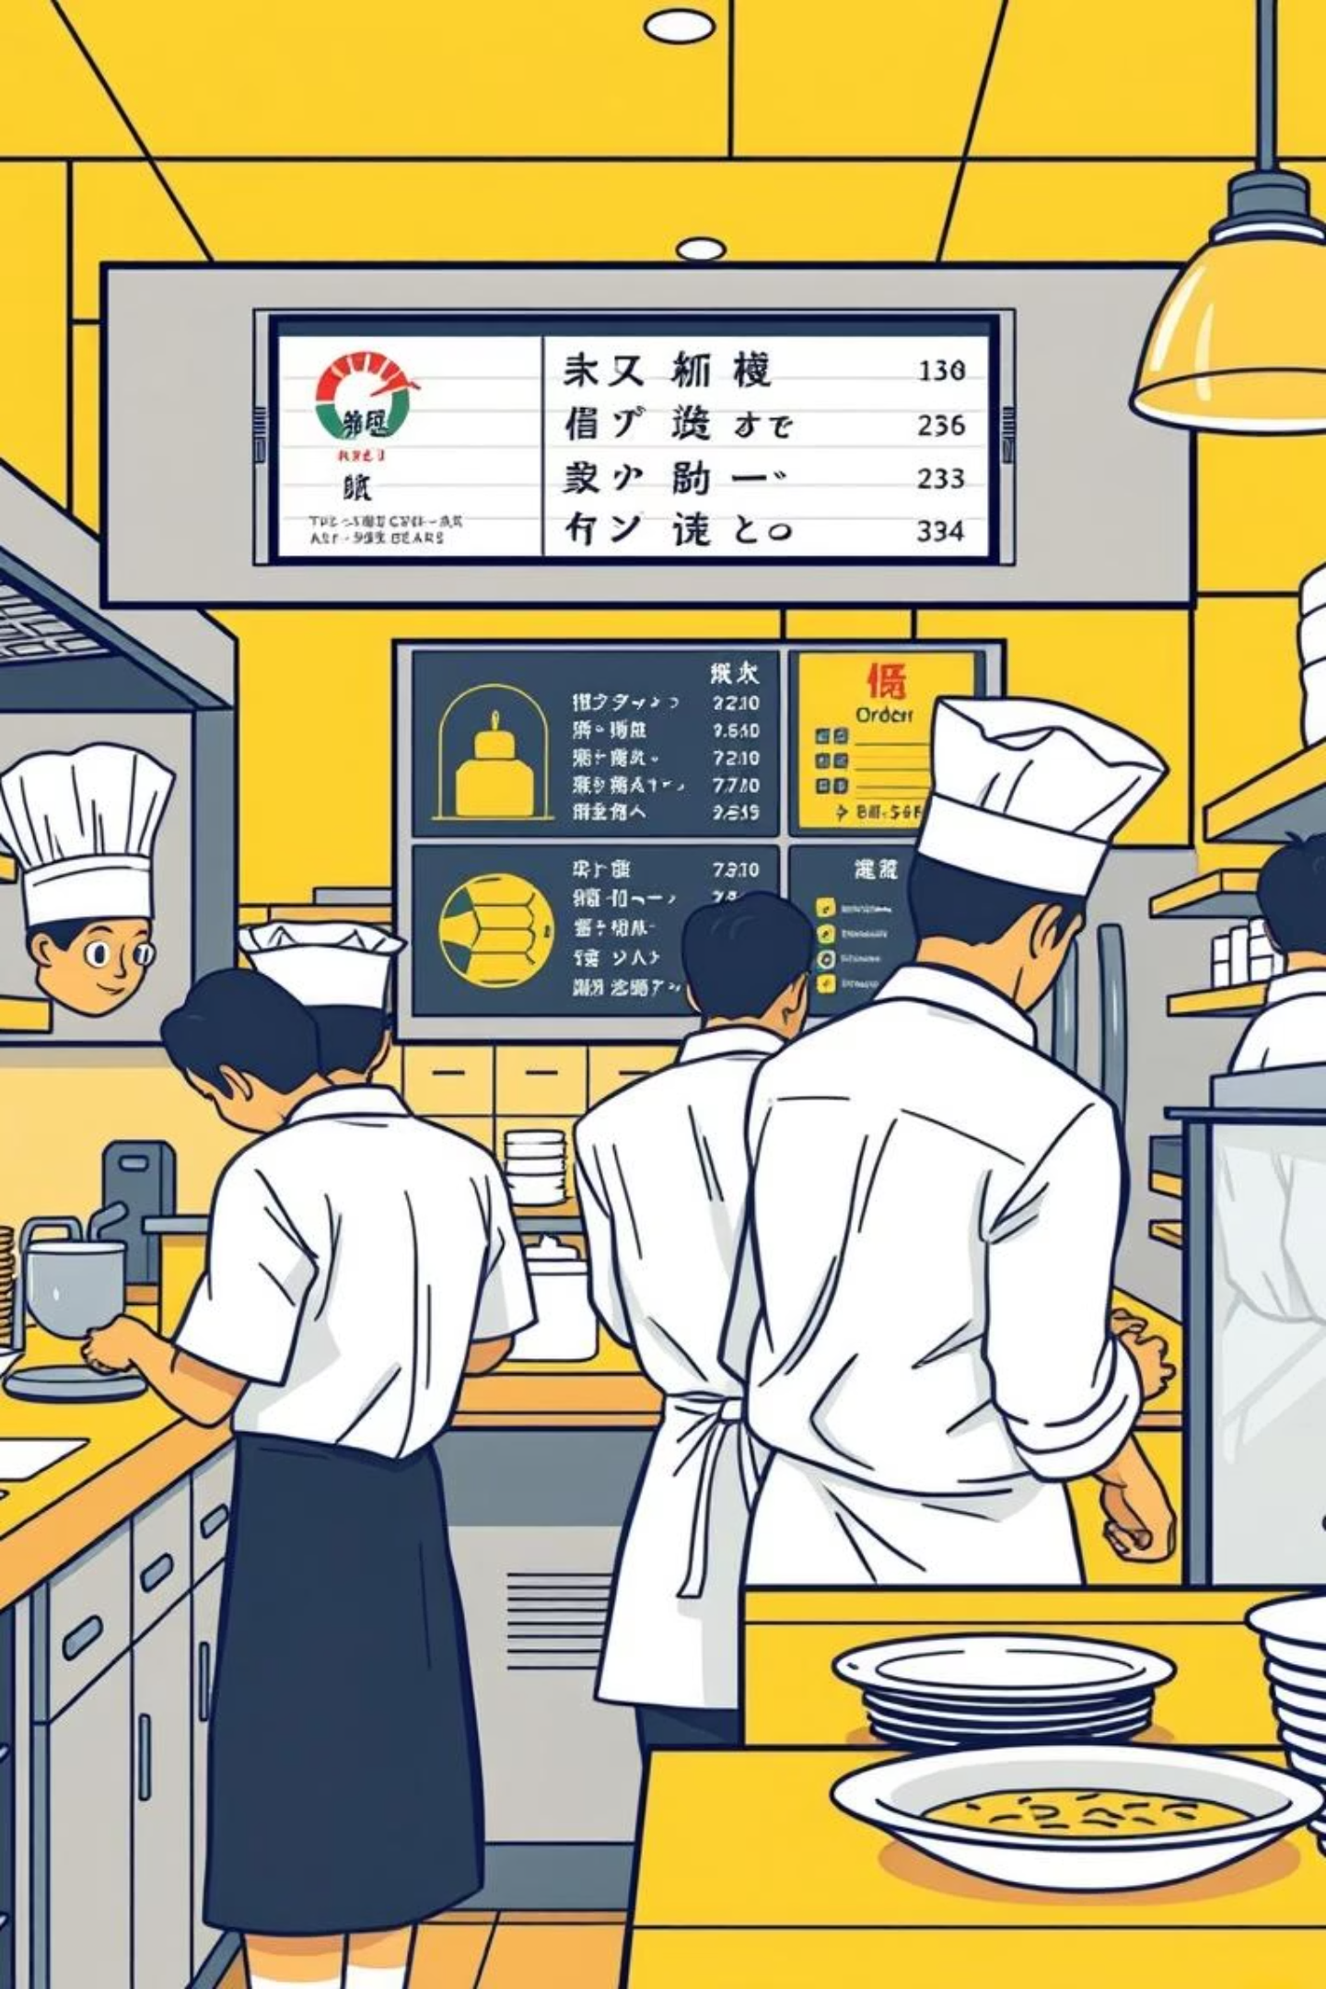
Restaurant Order Management System

Slide 2
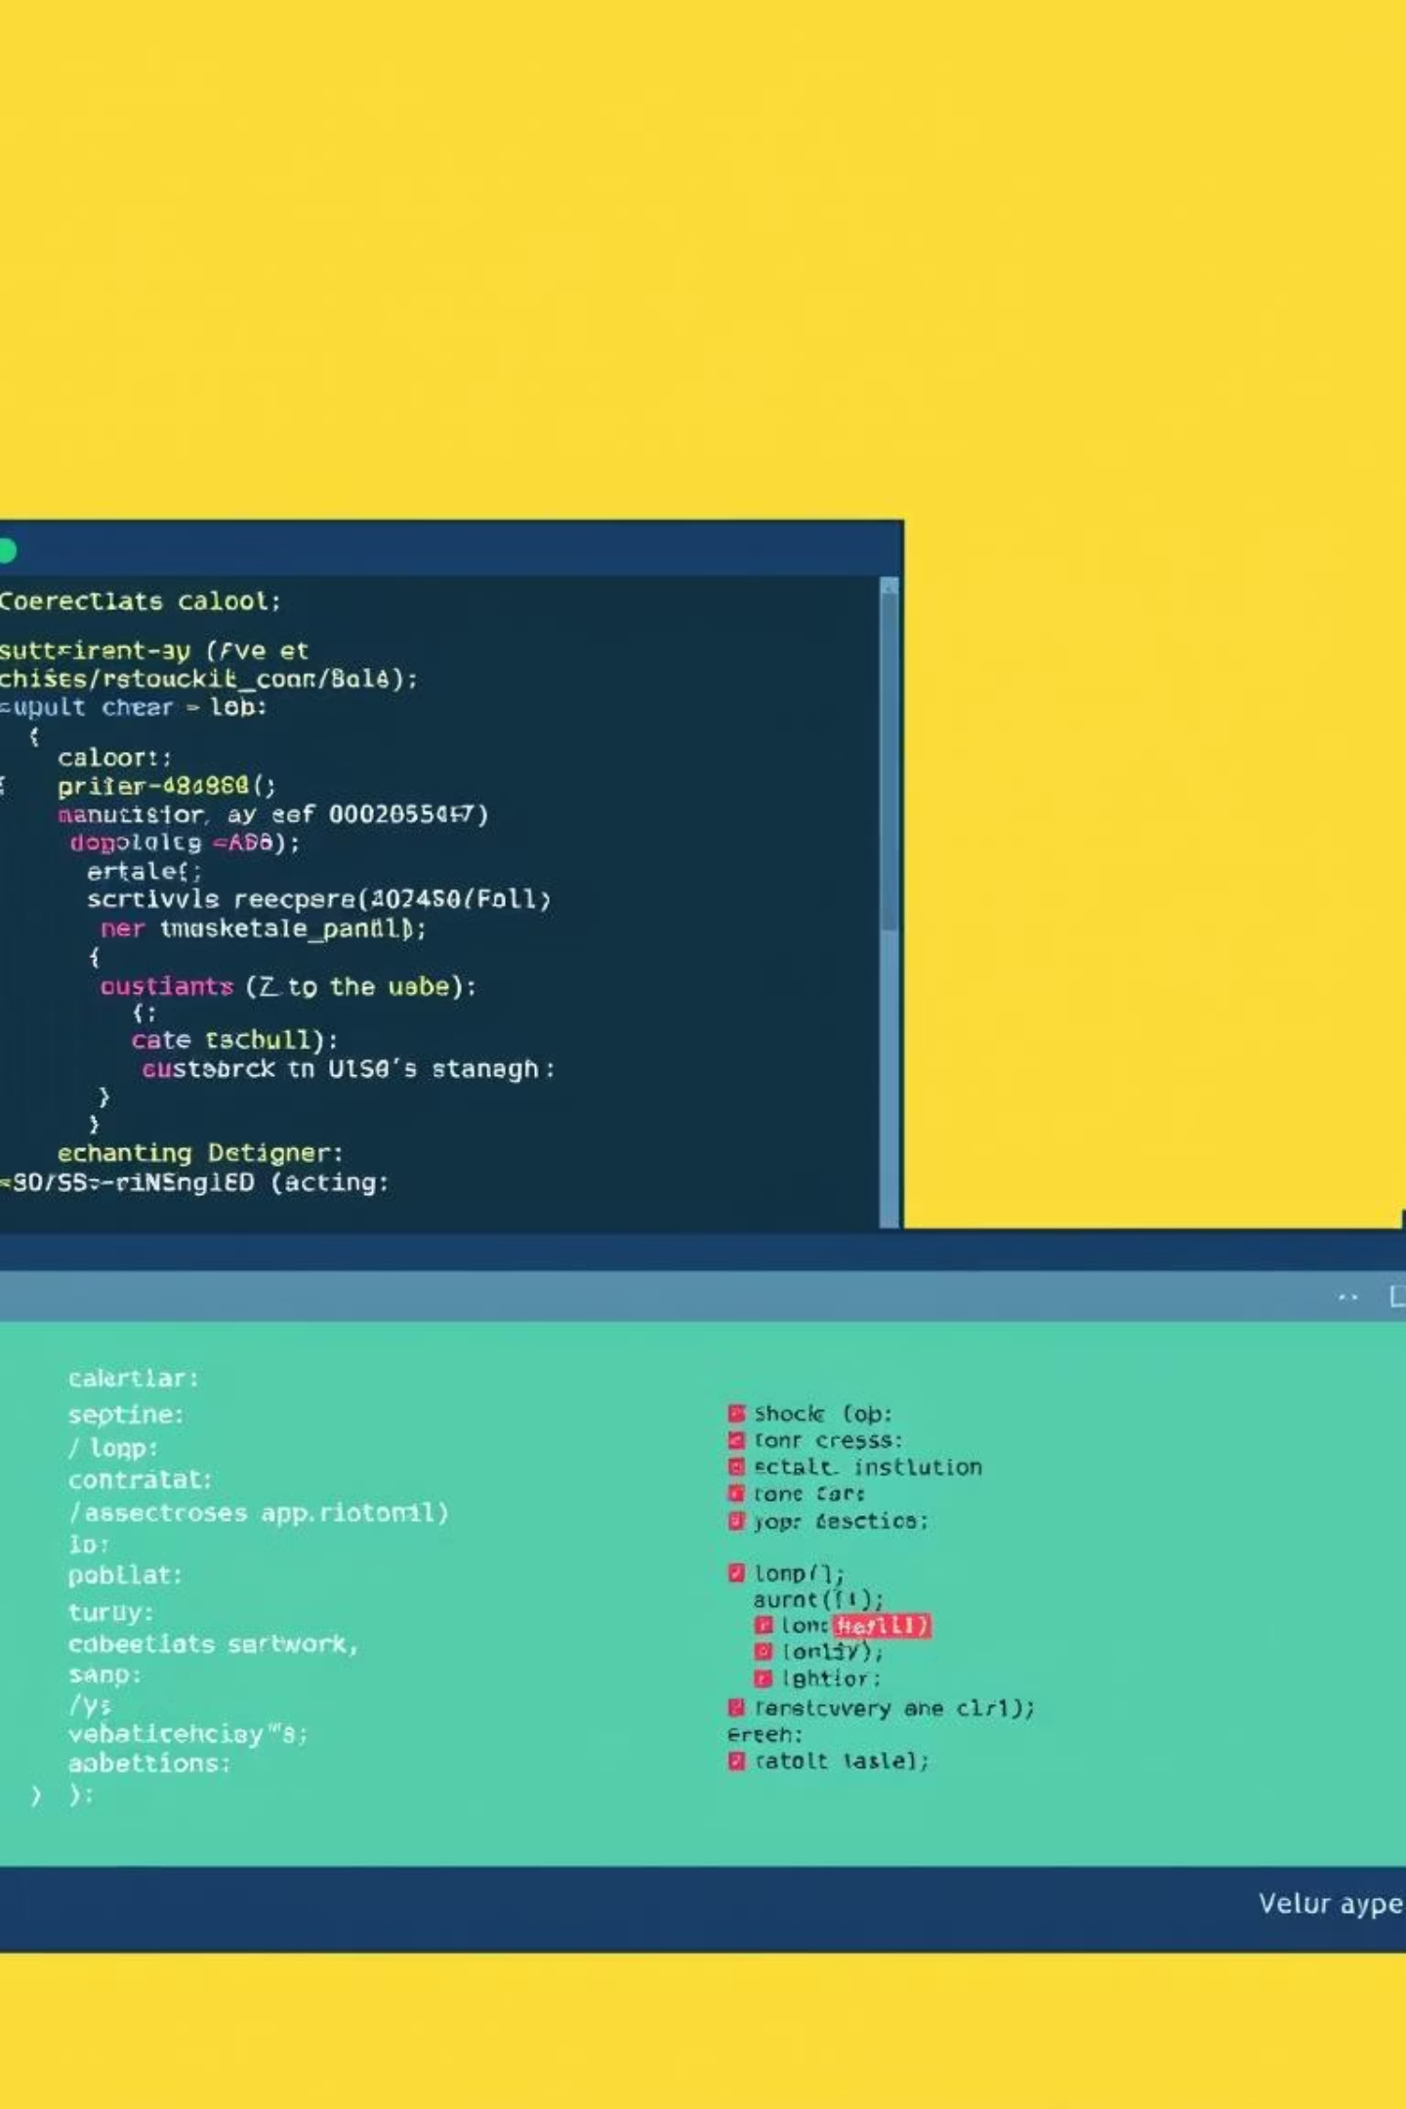
Introduction
This console-based C program efficiently manages restaurant orders. It allows customers to place orders, staff to process them, and managers to retrieve completed orders. It demonstrates fundamental data structures in a real-world application.

Slide 3
Problem Statement
Restaurants need a simple, efficient system to manage orders. The system must accept multiple customer orders, process them in the order received, and store pending orders for FIFO processing.
Accept Multiple Orders
Process Sequentially
Store Pending Orders
From various customers.
Orders are processed in the exact order they are received.
Ensuring first-in, first-out processing.

Slide 4
Algorithm
Enqueue (Place Order into Queue)
Start
Check if the queue is full If yes, display "Queue is full" and stop
If queue is empty, set front = rear = 0
Else, update rear = (rear + 1) % MAX
Insert the new order at queue [rear]
Stop
Dequeue (Complete Order from Queue)
Start
Check if the queue is empty If yes, display "No pending orders" and stop
Retrieve order at queue [front]
If front == rear, set front rear = -1 (queue becomes empty)
Else, update front = (front + 1)% MAX
Return the retrieved order
Stop 6 3.Push (Insert Completed Order into Stack)
Start
Check if the stack is full If yes, display "Stack is full" and stop
Increment top = top + 1
Insert the order at stack [top]
Stop
Pop (Retrieve Last Completed Order from Stack)
Start
Check if the stack is empty If yes, display "No completed orders" and stop
Retrieve order from stack [top]
Decrement top = top 1
Return the retrieved order
Stop
Main Menu Algorithm
Start
Initialize empty queue and stack
Repeat until the user selects Exit: Display menu options Read user choice If choice = 1 Enqueue (Place Order) Display Queue (Pending If choice = 2 Orders) If choice = 3 Dequeue (Complete Order) and Push to Stack If choice = 4 → Display Stack (Completed Orders) If choice = 5 Pop (Retrieve Last Completed Order) If choice = 6 Exit Else, display "Invalid choice"
Stop

Slide 5
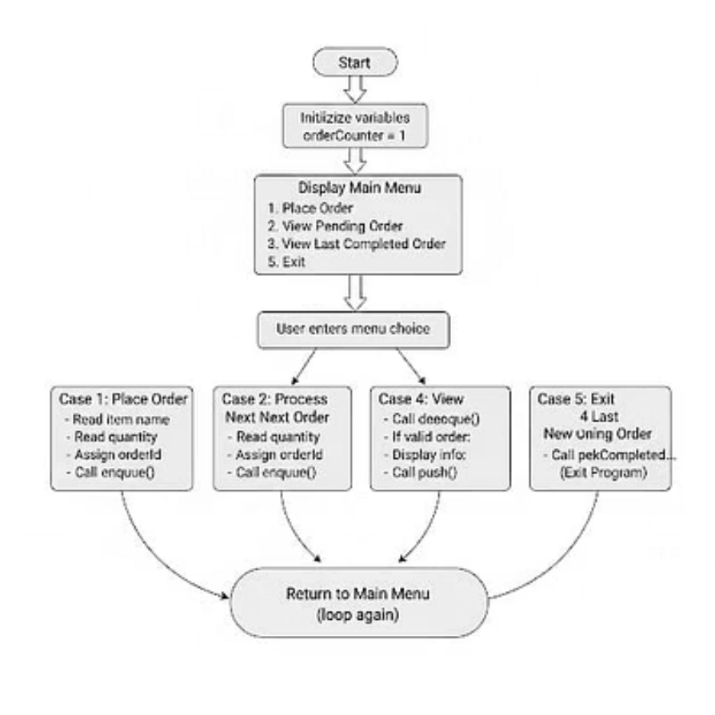
flow chart

Slide 6
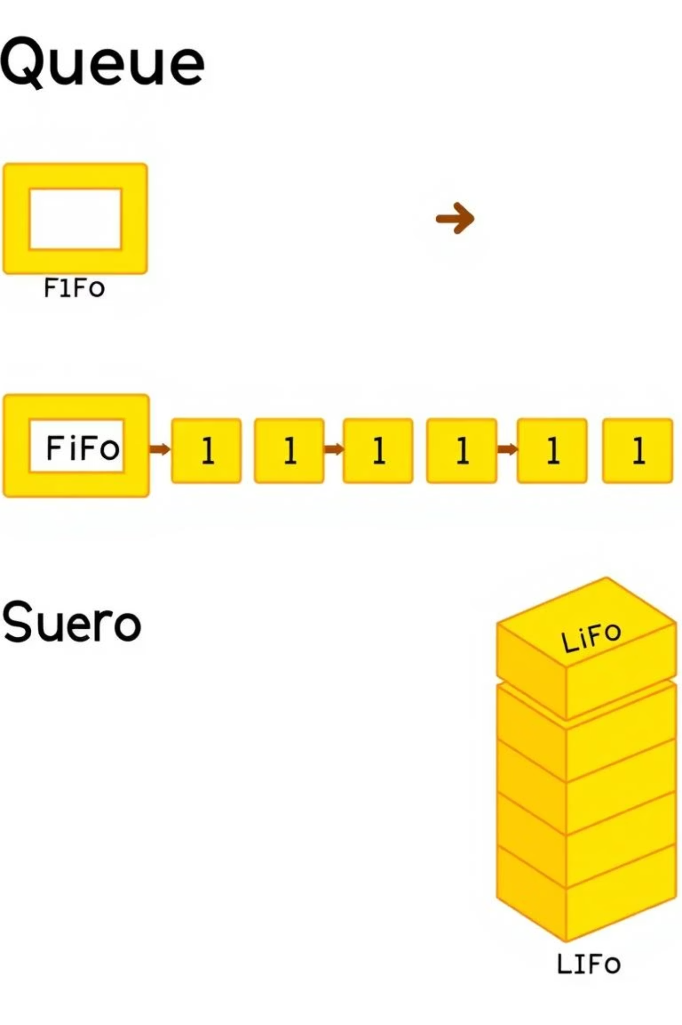
Data Structure Implementation
Queue (FIFO)
Stack (LIFO)
Ensures fair order processing: first in, first out.
Allows easy access to the most recent completed order: last in, first out.
Stores all pending customer orders.
Stores all completed orders.
Enqueue: adds new order at the rear.
Push: adds processed order to the top.
Dequeue: removes order from the front.
Pop: removes order from the top.
Example: queue[rear] = newOrder; and order = queue[front]; front++;
Example: stack[++top] = order;

Slide 7

Program Structure
The C program uses linked lists for dynamic queue and stack management, avoiding fixed size limits. Key functions include enqueue, dequeue, push, peekCompletedOrder, and viewPendingOrders.
#include <stdio.h>
#include <stdlib.h>
#include <string.h>typedef struct {int orderId;char itemName[50];int quantity; } Order;typedef struct QueueNode {Order order;struct QueueNode* next;} QueueNode;QueueNode *front = NULL, *rear = NULL;typedef struct StackNode {Order order;struct StackNode* next;} StackNode;StackNode* top = NULL;void enqueue(Order o) {QueueNode* temp = (QueueNode*)malloc(sizeof(QueueNode));temp->order = o;temp->next = NULL;if (rear == NULL) {front = rear = temp;}else {rear->next = temp; rear = temp;}printf(" Order placed: %s x%d\n", o.itemName, o.quantity); }Order dequeue() {if (front == NULL) {printf(" No pending orders.\n");Order empty = {-1, "", 0};return empty;}QueueNode* temp = front;Order o = temp->order;front = front->next;if (front == NULL) rear = NULL;free(temp); return o;}
void push(Order o) {StackNode* temp = (StackNode*)malloc(sizeof(StackNode));temp->order = o;temp->next = top;top = temp;}void peekCompletedOrder() {if (top == NULL) {printf(" No completed orders.\n");return;}printf(" Last Completed Order: %s x%d (ID: %d)\n", top->order.itemName, top->order.quantity, top->order.orderId);}void viewPendingOrders() {if (front == NULL) {printf(" No pending orders.\n"); return;}QueueNode* temp = front;printf(" Pending Orders:\n");while (temp != NULL) {printf(" - %s x%d (ID: %d)\n", temp->order.itemName, temp->order.quantity, temp->order.orderId); temp = temp->next;} }int main() {int choice, orderCounter = 1;Order o;do {printf("\n Restaurant Order Management System\n");printf("1. Place Order\n");printf("2. Process Next Order\n");printf("3. View Pending Orders\n");printf("4. View Last Completed Order\n");printf("5. Exit\n");printf("Enter your choice: ");scanf("%d", &choice);switch(choice) { case 1: printf("Enter item name: ");scanf(" %[^\n]", o.itemName); printf("Enter quantity: "); scanf("%d", &o.quantity);
o.orderId = orderCounter++; enqueue(o); break; case 2: o = dequeue(); if (o.orderId != -1) { printf(" Processing Order ID %d: %s x%d\n", o.orderId, o.itemName, o.quantity); push(o); printf(" Order completed.\n"); } break;case 3:viewPendingOrders();break;case 4:peekCompletedOrder();break;case 5: printf(" Exiting... Goodbye!\n"); break; default: printf(" Invalid choice. Try again.\n"); }} while (choice != 5);return 0;}

Slide 8
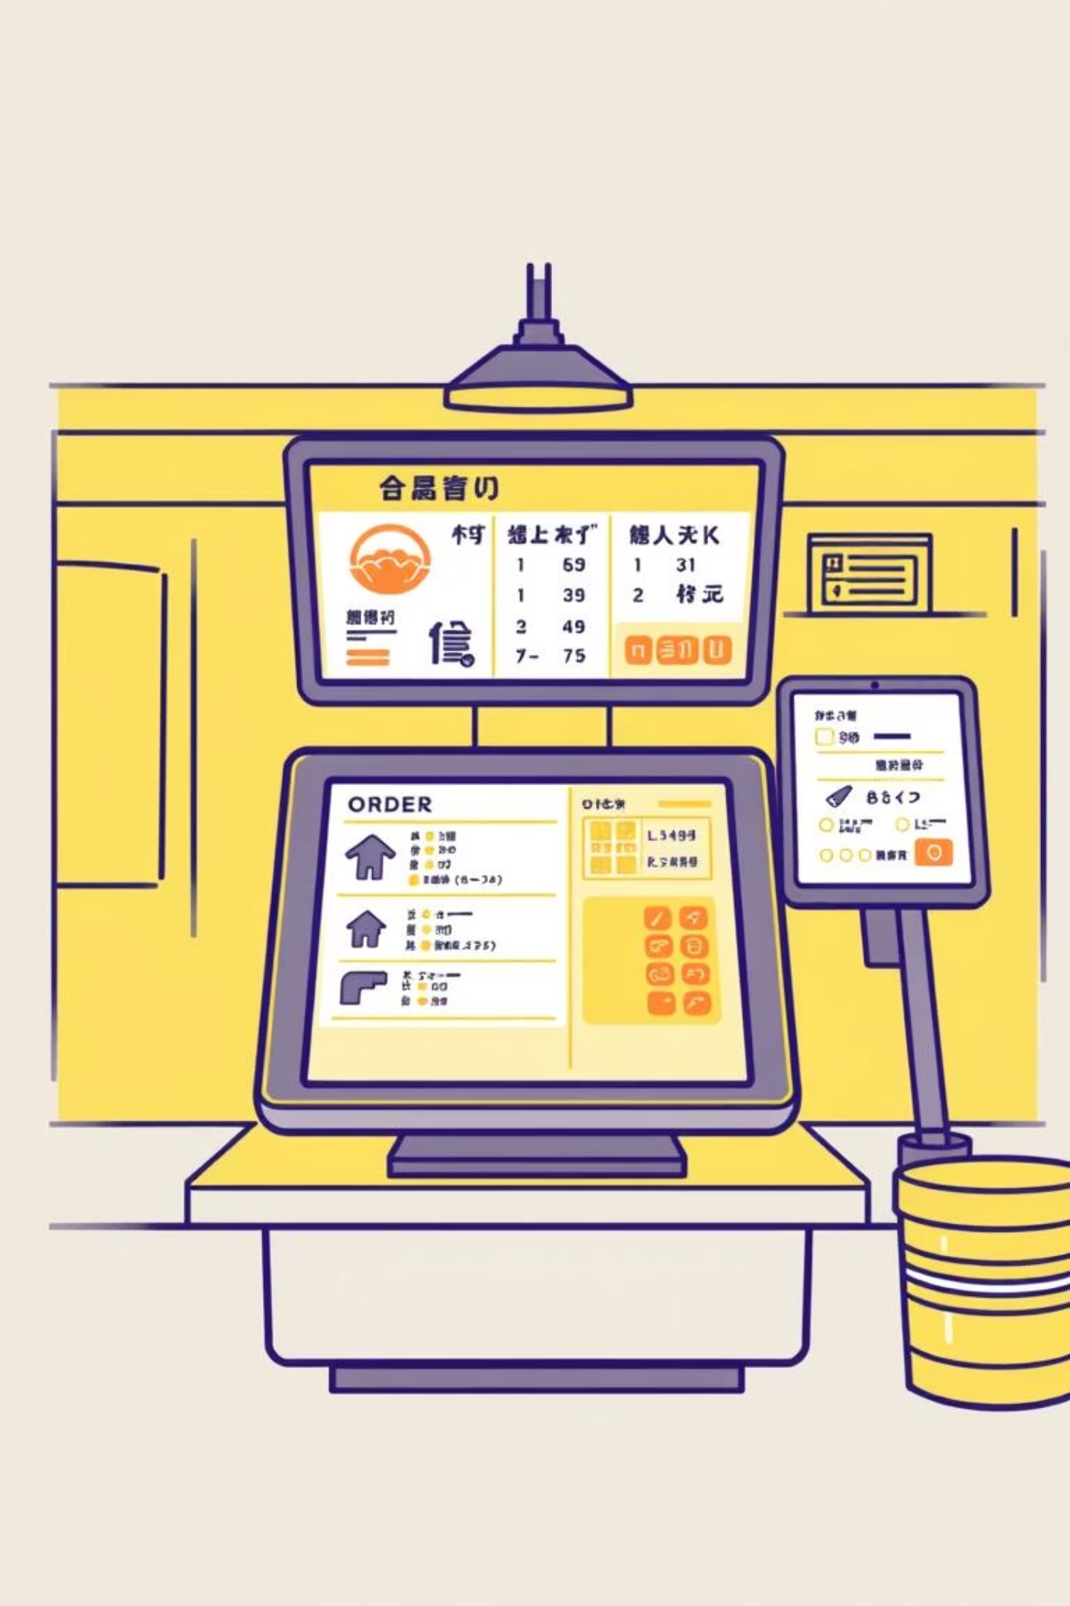
Sample Output: Placing and Processing Orders
The system provides a clear menu for interaction. Customers can place orders, which are then processed sequentially. The example shows placing an order for "Pasta" and its subsequent processing.
Show Menu
Displays available items and prices.
Place Order
Customer selects items and quantity. Order 1 placed for Adam.
Process Order
Order 1 for Adam (Pasta x1) is processed and completed.

Slide 9
• Sample output
show menu
RESTAURANT ORDER SYSTEM
Show Menu
Place Order
Process Order
View Pending Orders
View Last Completed Order
Exit
Enter choice: 1
MENU
Burger - Rs.99.00
Pizza - Rs.199.00
Pasta - Rs.149.00
Coffee - Rs.49.00
IceCream - Rs.89.00
Place order
Enter choice: 2
Enter customer name: Adam
--- MENU ---
Burger Rs.99.00 2. Pizza Rs.199.00 3. Pasta Rs.149.00 4. Coffee Rs.49.00 5. IceCream Rs.89.00
Enter item number: 3
Enter quantity: 1
Add more items? (1=Yes, O=No): 0
Order 1 placed successfully for Adam! Total = Rs.149.00
Process order
--- RESTAURANT ORDER SYSTEM ---
Show Menu
Place Order
Process Order
View Pending Orders
View Last Completed Order
Exit
Enter choice: 3
Processing Order 1... Customer: Adam
Pasta x1 = Rs.149.00 Total: Rs.149.00
Order Completed!
View pending orders
--- RESTAURANT ORDER SYSTEM ---
Show Menu
Place Order
Process Order
View Pending Orders
View Last Completed Order
Exit
Enter choice: 4
No pending orders!

Slide 10

Sample Output: Viewing Orders
Users can view pending orders and the last completed order. After processing, the pending orders list becomes empty, and the completed order is accessible.
View Pending Orders
View Completed Orders
System confirms "No pending orders!" after processing.
Displays details of the last completed order.
Enter choice: 4No pending orders!
Enter choice: 5

Slide 11
• sample output viewing
view completed orders
RESTAURANT ORDER SYSTEM
Show Menu
Place Order
Process Order
View Pending Orders
View Last Completed Order
Exit
Enter choice: 5
📕 Last Completed Order 1
Customer: Adam
Pasta x1 = Rs.149.00
Total: Rs.149.00

Slide 12

Advantages & Disadvantages
✅ Advantages
❌ Disadvantages
Separation of Concerns: Queue for pending, Stack for completed orders.
Limited Historical Tracking: Only last completed order easily accessible.
Simple & Intuitive: Mimics real-world order handling.
No Order Cancellation/Update: Lacks flexibility.
Efficient for Small-Scale: Fast operations, dynamic memory.
No Persistence: Data lost on exit.
Modularity: Easy to maintain and expand.
Memory Leaks Risk: Requires proper cleanup.
Scalability Limitations: Single-user, command-line only.

Slide 13

Conclusion
This Restaurant Order Management System effectively uses Queues for pending orders and Stacks for completed orders. It ensures fair processing, quick access to recent orders, and offers an easy-to-use interface, making order management smooth and effective for small-scale operations.

